Slide 1
CRACKING CARDS
The three course meal of the component world

Slide 2
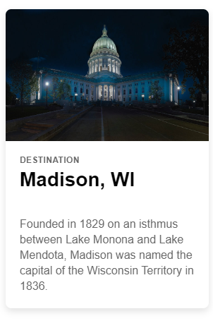

Cracking Cards
Maybe not the most popular component in Ionic, but definitely one of the most useful!
Cards help to organise content
Cards can be used as single components or are presented with headers, content and footers
Here’s how neat we can make things look with cards
Let’s add a few cards to our app that gives us more info on Past and Current deliveries…

Slide 3
CHALLENGE TIME!
Add a few cards to your mobile app and play with the styling a little
Share a screen shot on our Discord Community!

